Slide 1




RatesPerk
Team : -
Netra Awate
001529534
Sakshi Nayak
002193939
Taru Shukla
002193864
Git : -
https://github.com/Price-Comparison-Businesses-System/Price_Comparison_Businesses_System.git

Slide 2
RatesPerk
Problem Statement : -
Comparison platform for all enterprise and organizational items from multiple small e-commerce ecosystems for the customer to have inexpensive shopping experience.
To cater customer inconvenience while considering all the available options from online websites to remote stores at one place for vital enterprises.
Provide statistical view to the Enterprise owners in terms of graph to enhance the service and increase revenue.

Slide 3
RatesPerk
Approached Solution :-
Each item from the Enterprise is displayed for the comparison from different City as the common Network.
Example: Snow jackets have different prices in Boston and Arlington!
Wide spectrum of Enterprises considered ->
Clothing, Transport, Health Care, Electronics, Food Products
Every Enterprise provides possibility to search and compare an item for its own features.
Example: A car can be bought or rented, Meal can be provided by a Restaurant or cooked at home!

Slide 4
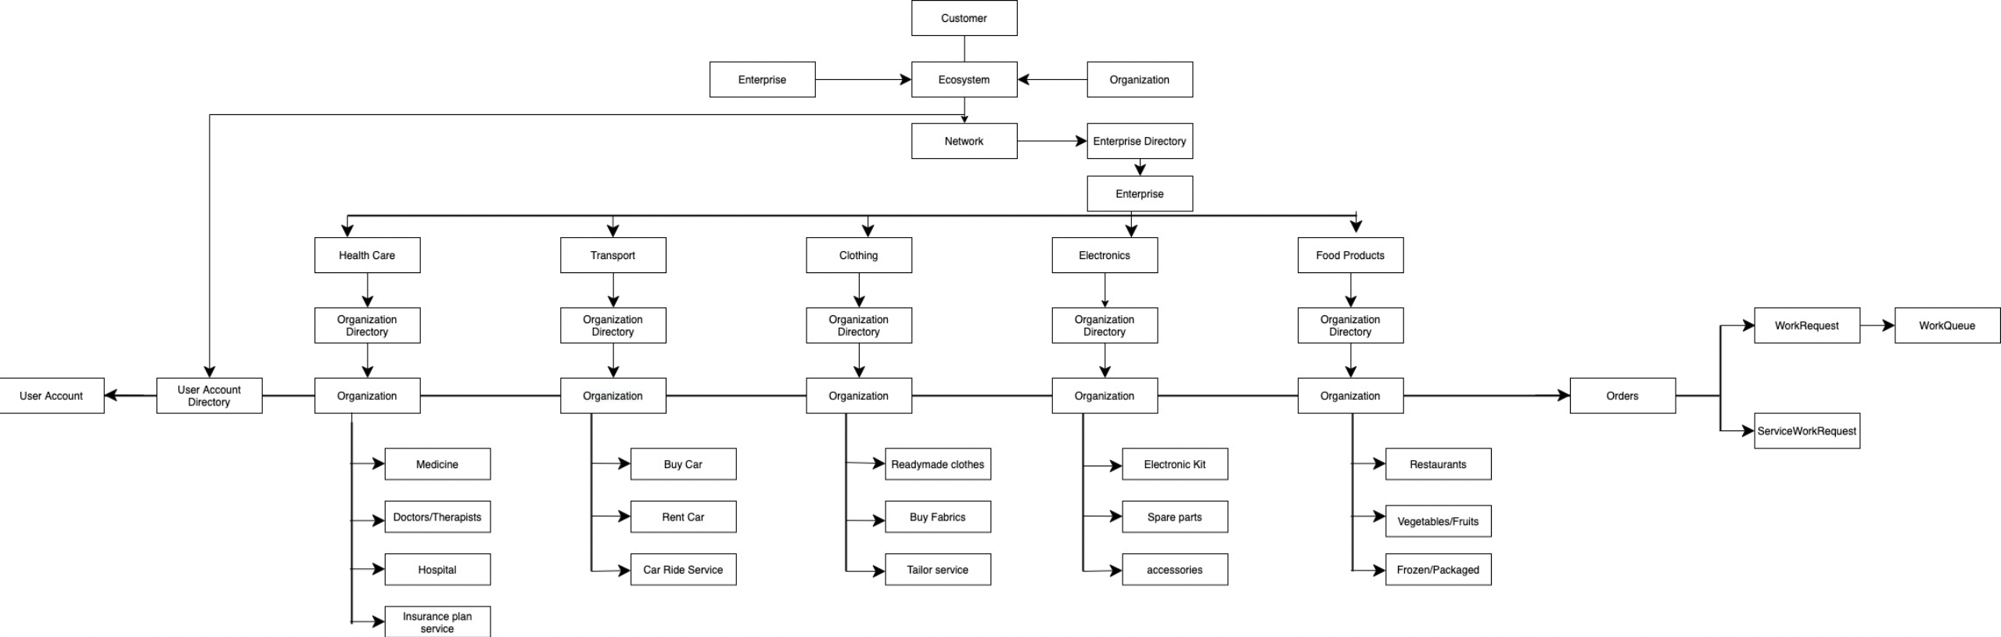
RatesPerk
UML :-

Slide 5
RatesPerk
Customer
Enterprise
Ecosystem
Organization
Clothing
Transportation
Electronics
Health Care
Food Products
Fabric
Buy Car
Kit
Hospitals
Restaurants
Cloths
Rent Care
Spare parts
Doctors
Pacakaged
Tailor services
Ride services
Accessories
Medicine
Vegetables
Insurance plan providers

Slide 6
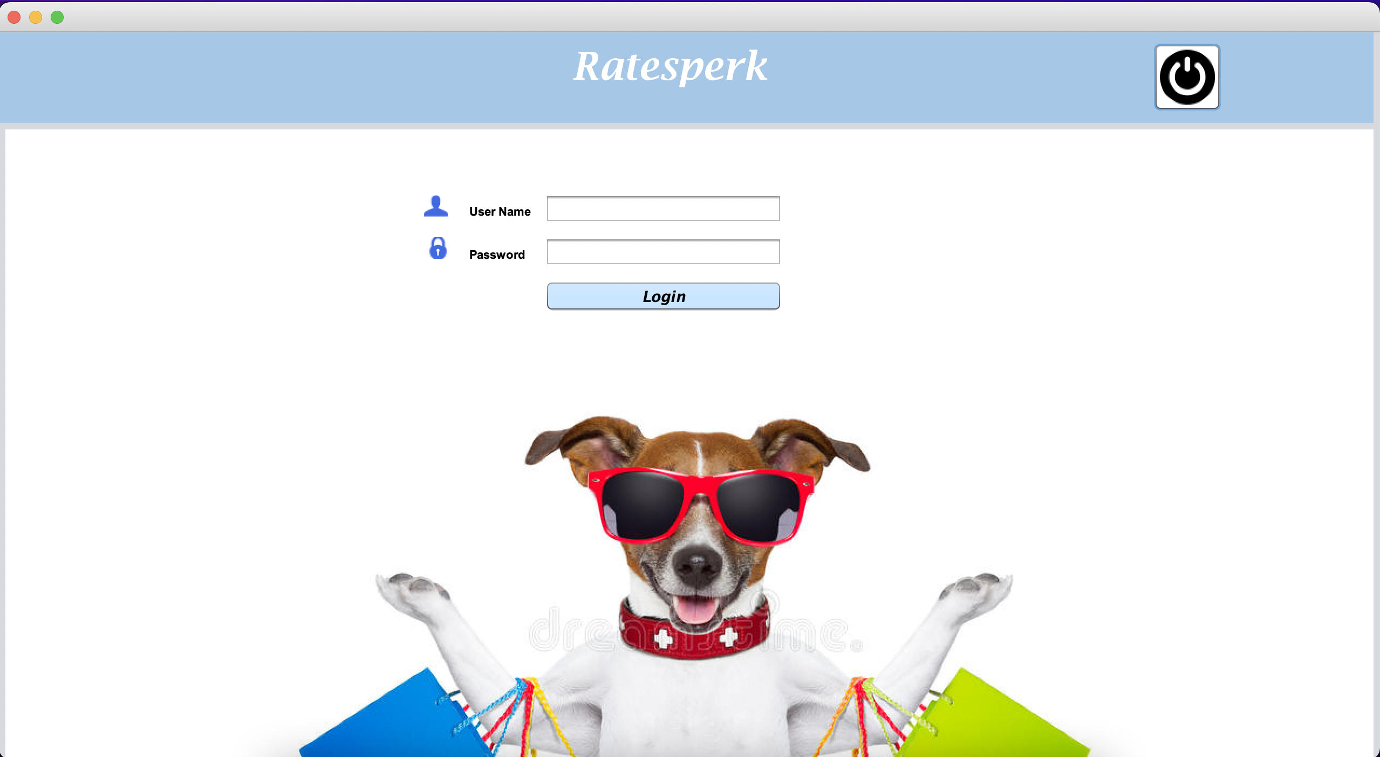
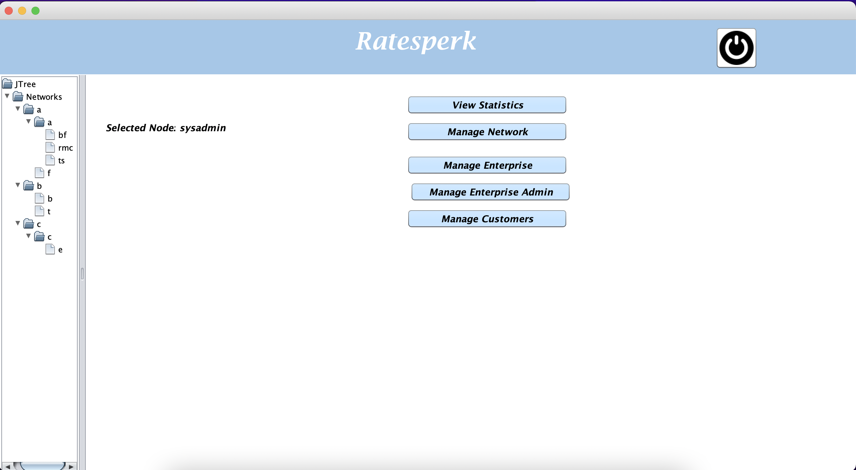
RatesPerk
Processes:

Slide 7
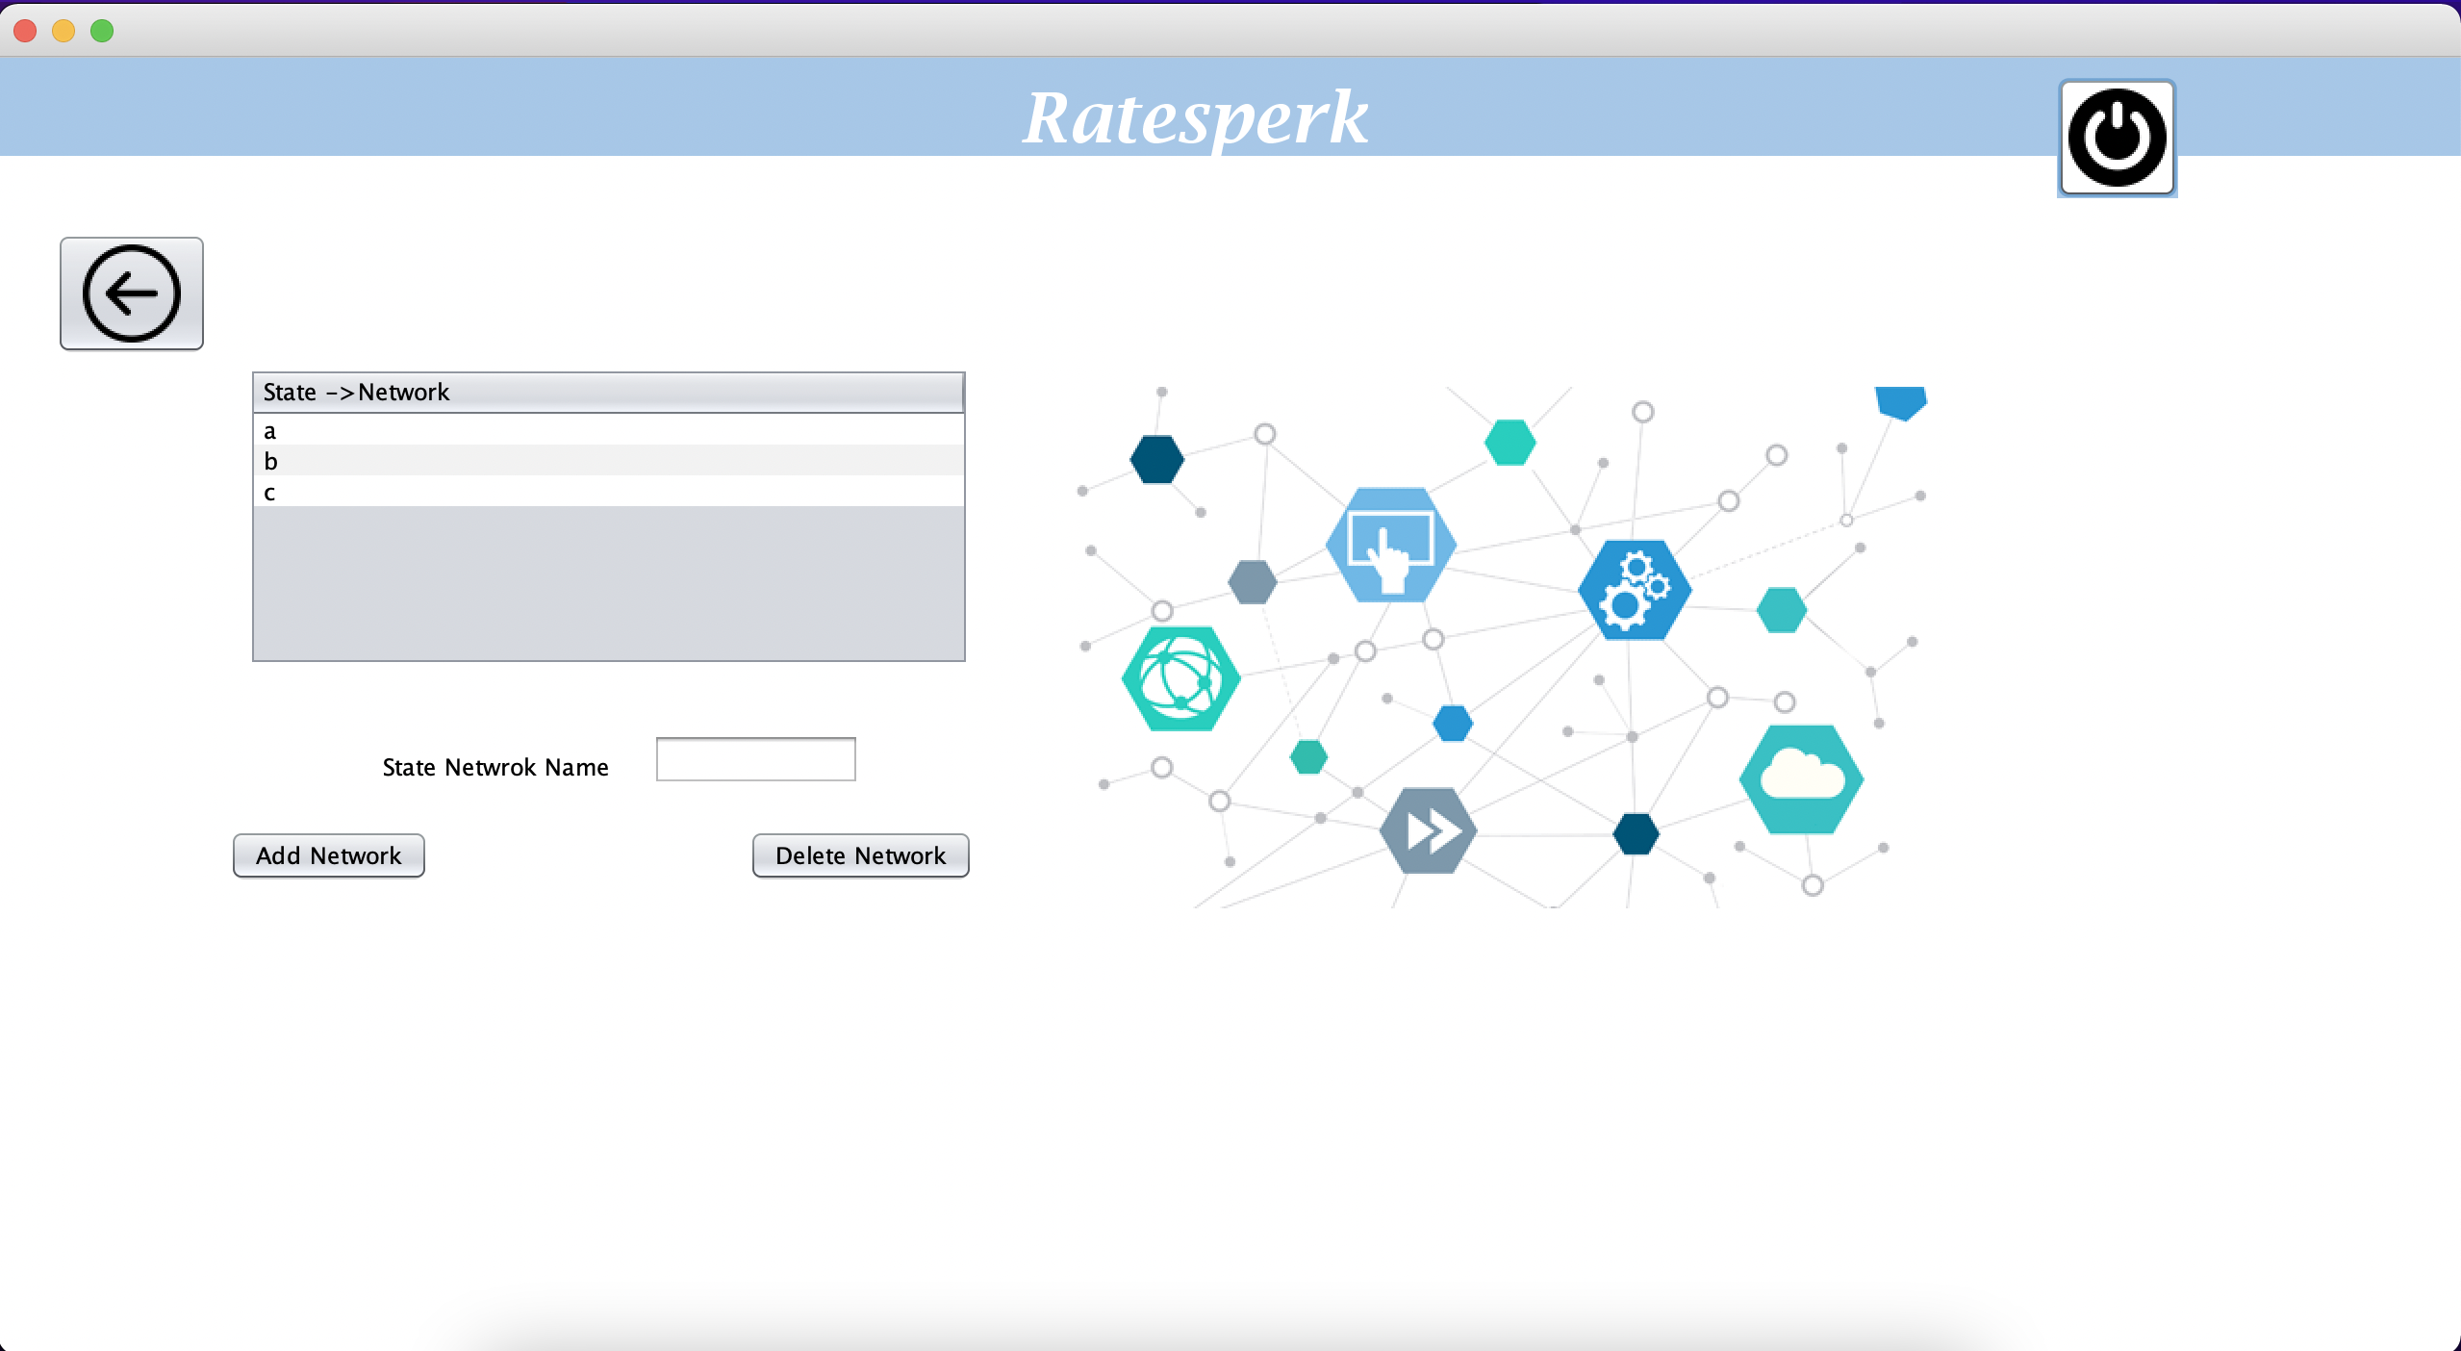
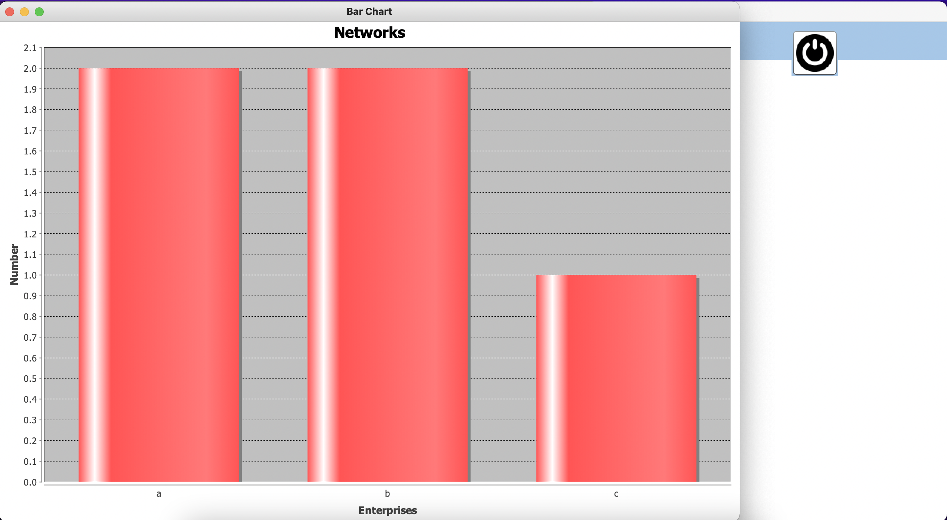
RatesPerk

Slide 8
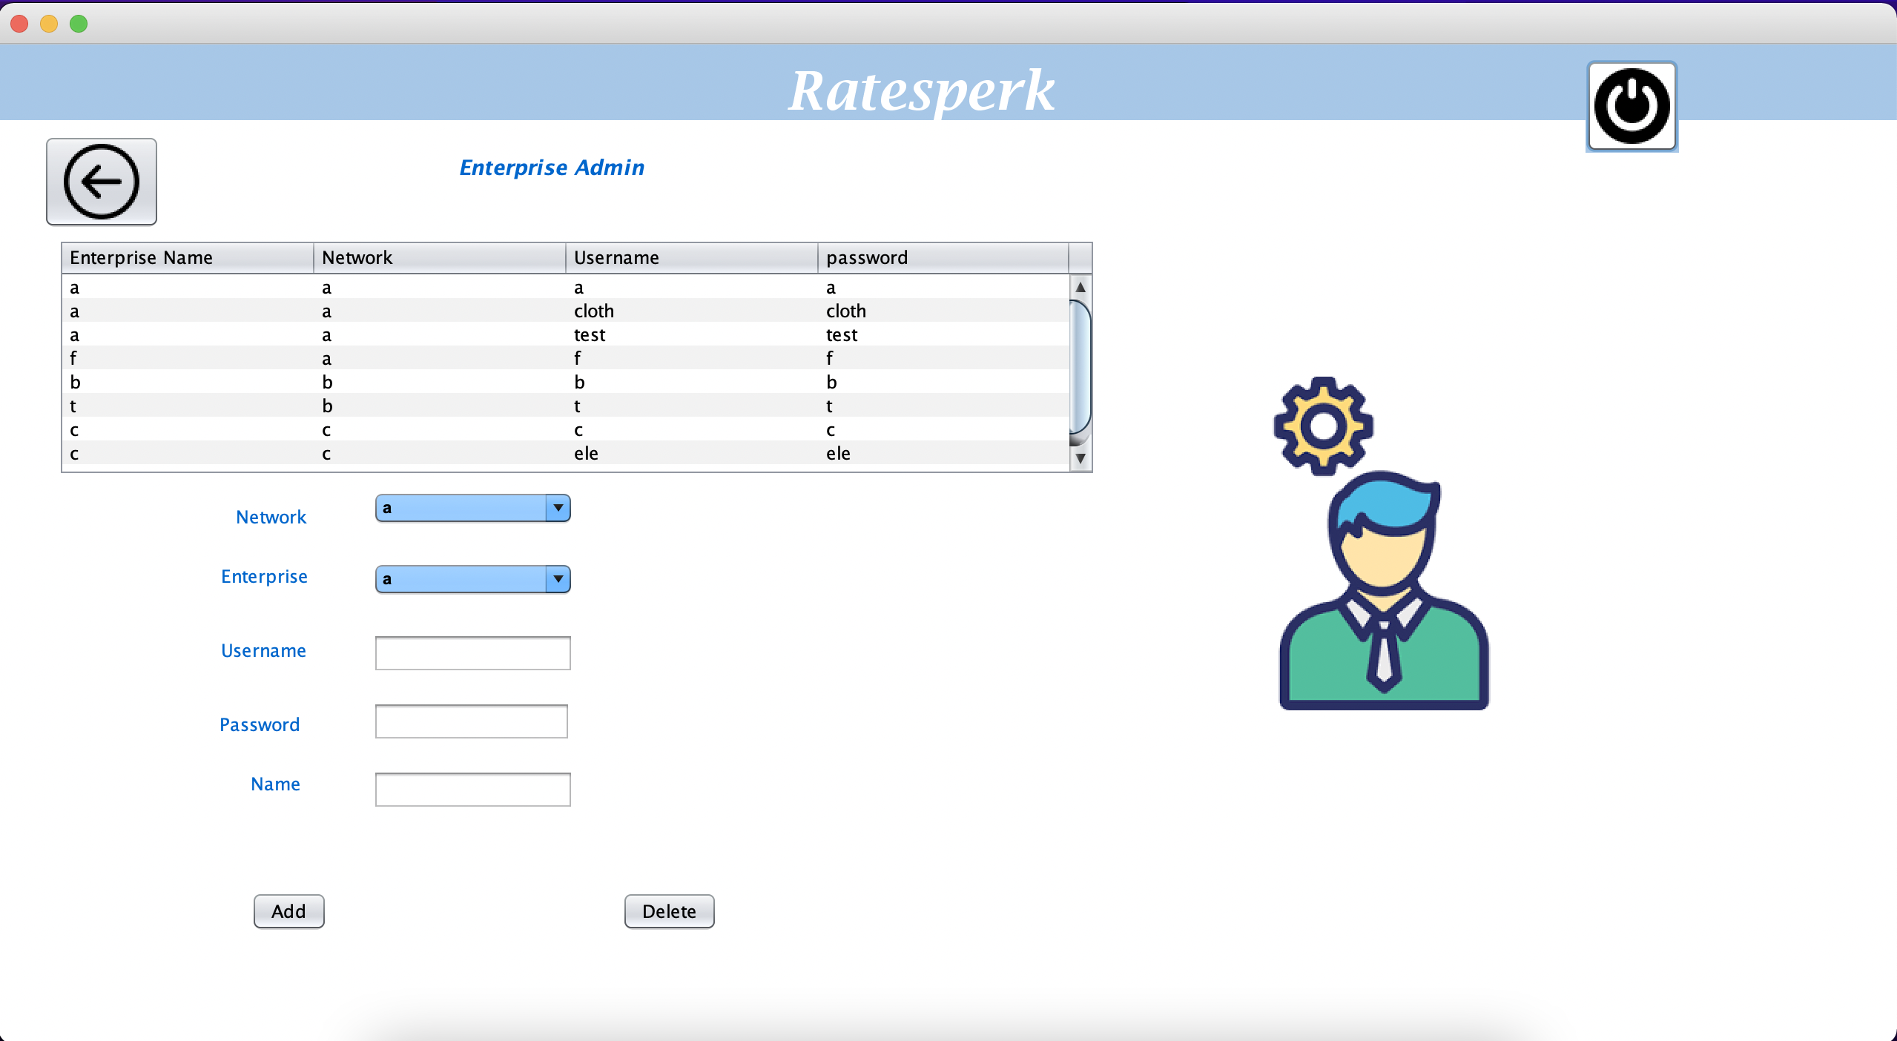
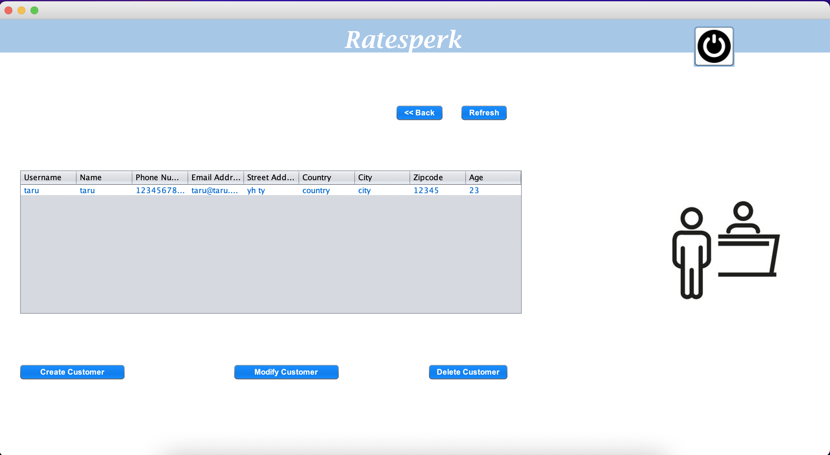
RatesPerk

Slide 9
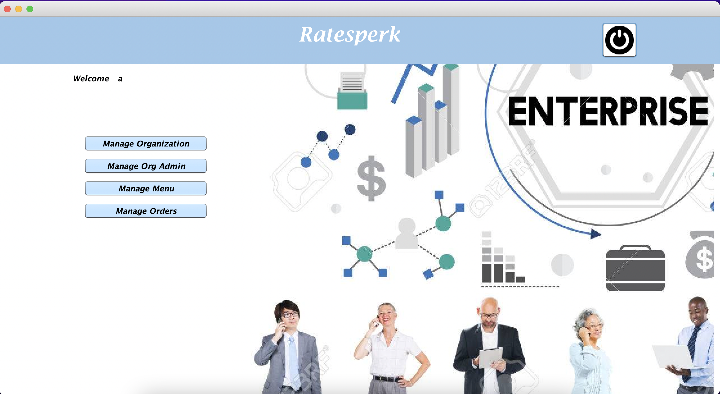
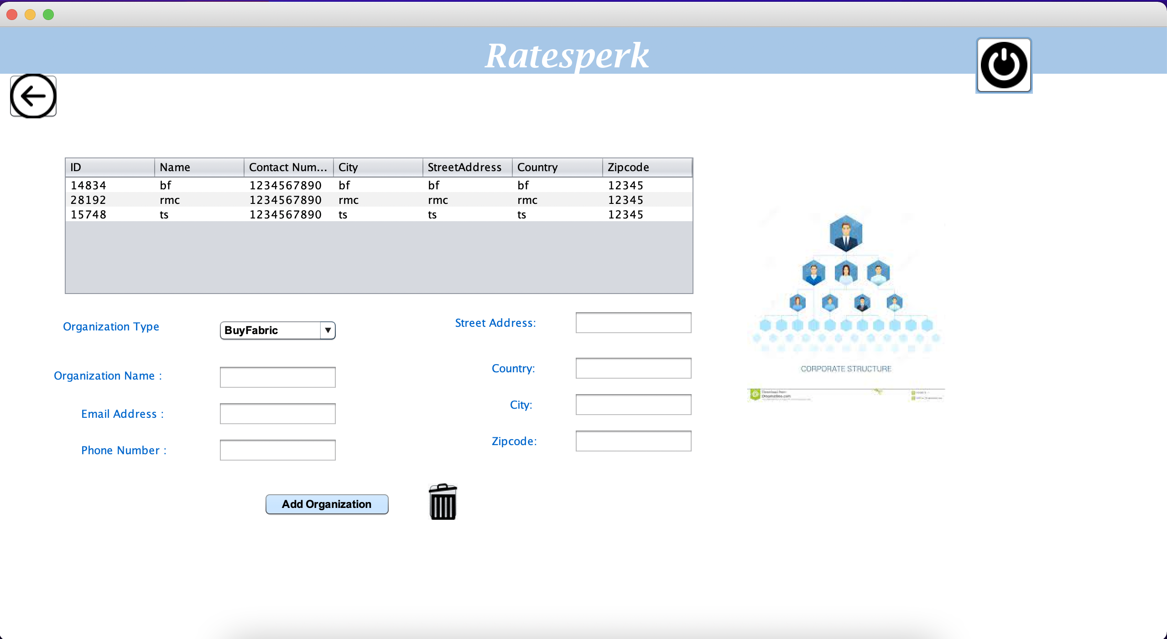
RatesPerk

Slide 10
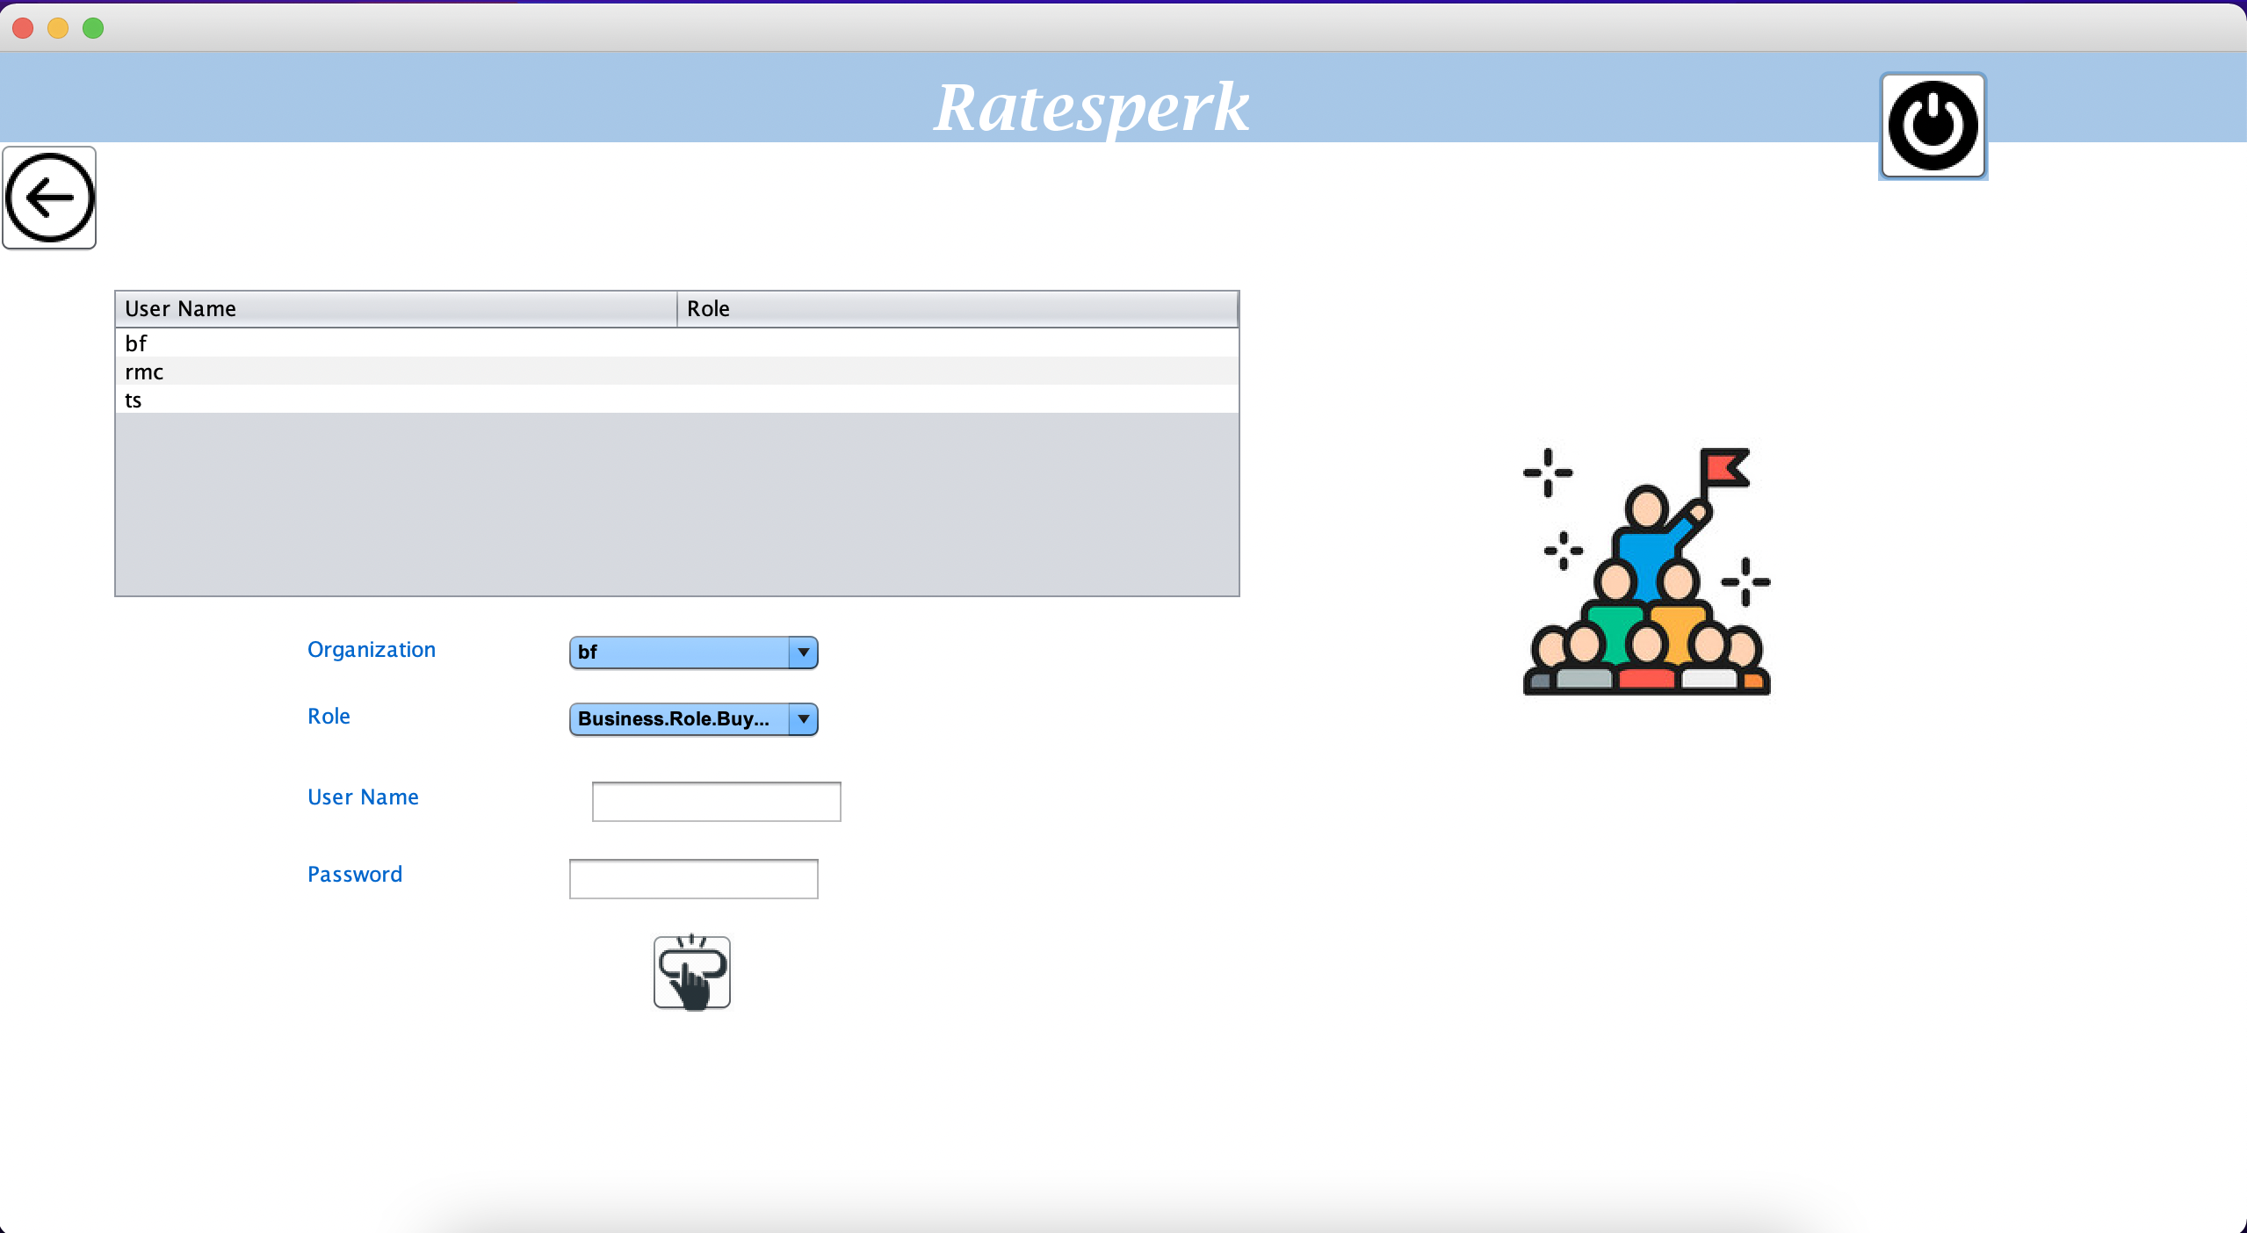
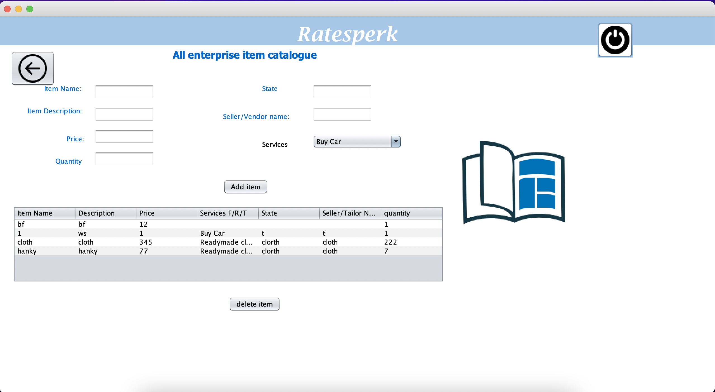
RatesPerk

Slide 11
Hope you enjoy Shopping!
RatesPerk

